Slide 1
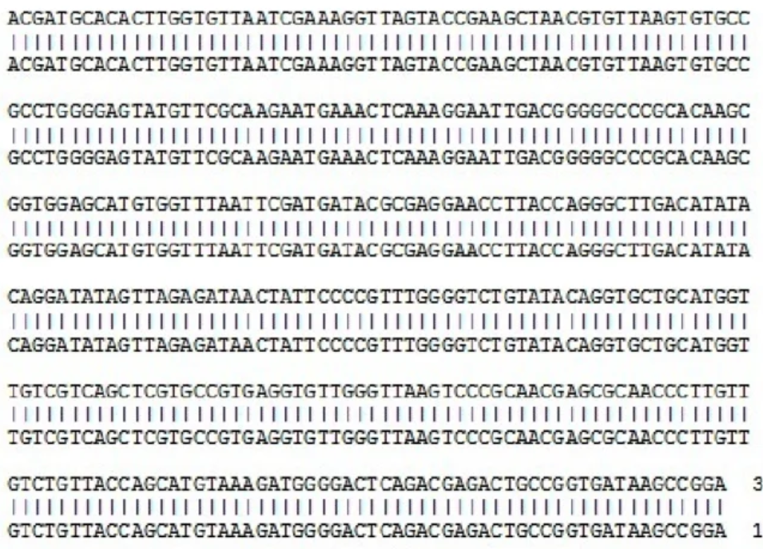
mini-BLAST
A BLAST-like Tool for Multiple
Local Alignment
02-604 Term Project
Makayla McCreary
Vedika Sridhar
Neha Thakar
Sriya Veeramachaneni
APR 2026
Notes:
Image source: https://www.researchgate.net/figure/A-A-BLAST-sequence-alignment-report-from-the-GenBank-validates-the-sequences_fig4_263433084

Slide 2
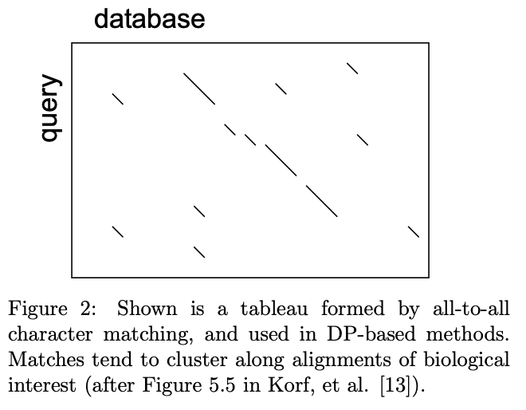
Background
Why align sequences?
The BLAST Heuristic
Exact alignment algorithms are slow and expensive at scale
Observation: sparse distribution of high-scoring character matches in DP alignment matrix
Seed-and-extend: identify these high-potential alignment locations → accelerate local alignment time
Infer conserved functionality, structural similarity, shared ancestry
Identify unknown samples
Detect mutations

Slide 3
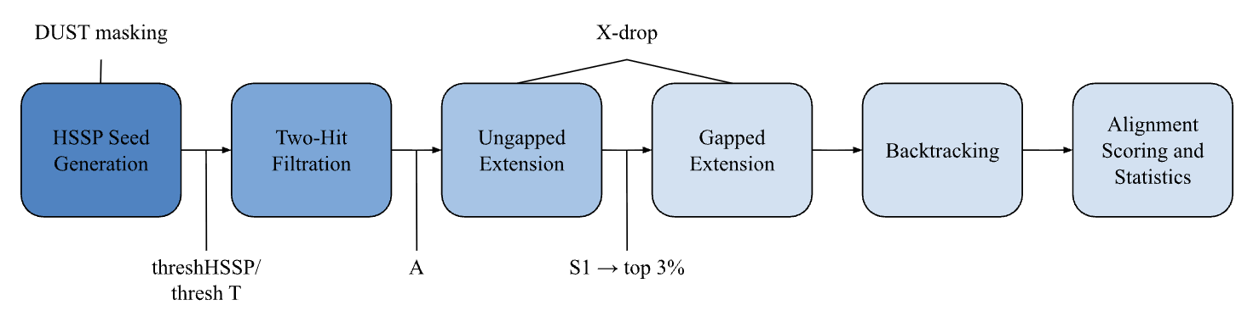
mini-BLAST Pipeline
Inputs: a query sequence (FASTA file or string), reference database (FASTA file), and a two-hit diagonal window (A)
↳ Supports both DNA or protein sequence input. Additional parameters corresponding to sequence type are inherent to the program.
Figure 1: pipeline overview highlighting several thresholding mechanisms and checkpoints
Outputs: the maximal scoring alignments of query sequence against reference sequences given input parameters, with alignment evaluation statistics (query coverage, percent identity, raw score, bit score, E-value)

Slide 4
Step 1: Seed generation
Query: ATTCAGTAAGATCGATC
Branch and bound HSSP generation
ATT, ATA, ATG, ATC, AAT, ACT, AGT, TTT, CTT, GTT, …
Goal: identify locations in a reference sequence with a reasonable chance of producing a good alignment to a query sequence
Seeds are based on ungapped alignments between query kmers and reference kmers
char | v
A | 0
C | 1
G | 2
T | 3
rKMER | rPOS
41 | 12
3 | 83
51 | 19
20 | 4
∑ v x 4^{k-p-1}
Nucleotides:
k : 7
threshHSSP: 9
Mismatch tolerance: 1
Match reward: 2
Mismatch penalty: 3
Proteins:
k : 3
threshT: 11
Scoring scheme: BLOSUM62
Seed: (qPos, rPos, score)

Slide 5
Step 2: Two-hit filtration
Examine a specific highlight more closely. In a few words, explain why this insight is important and how it applies to the upcoming quarter.

Slide 6
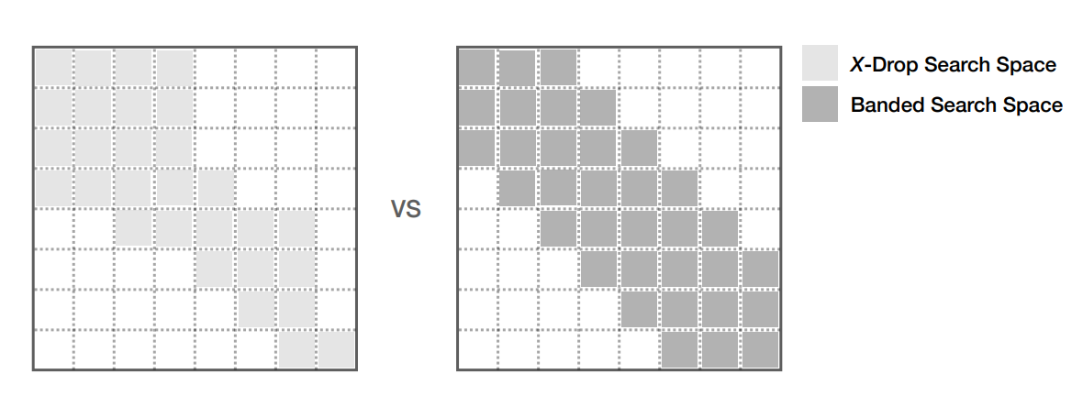
Step 3: Extension
Ungapped Extension
X-drop heuristic: Stop extending the seed when the alignment score drops X below the maximum score achieved so far
The X-drop heuristic enables adaptive banding, allowing the alignment to explore more freely and produce better quality alignments.
Greedy bidirectional extension anchored at the seed
X-drop cuts off the alignment when it has depreciated too much
S₁ Threshold
E-value–based statistical threshold – which of the ungapped alignments are statistically significant?
Due to limited compute power, we are taking the top 3% of significant hits for gapped extension
Notes:
The first step in extension is to perform an ungapped extension of all seeds that passed the 2-hit filtration stage. During all extension stages, we are using the X-drop heuristic which stops the extension when the alignment score drops X below the greatest score seen so far. This is an adaptive banding method that aims to reduce the search space while still allows the alignment to explore more freely, rather than using a strict distance-based band. The ungapped extension stage is put through an S1 threshold, which aims to reduce noise and further refine the number of seeds passed to gapped extension. S1 is usually a statistical threshold, keeping only ungapped alignments that are significant. Here, we are using S1, then further taking only the top 3% for gapped alignment due to limited compute power.
Xdrop image source: https://people.eecs.berkeley.edu/~aydin/ipdps_logan_2020.pdf

Slide 7
Step 3: Extension
Gapped Extension
Examine a specific highlight more closely. In a few words, explain why this insight is important and how it applies to the upcoming quarter.
Backtracking
Notes:
The seeds that pass the S1 threshold then go into the most computationally intense part of alignment – the gapped extension. We are using a 3-state DP matrix to support affine gap penalties and maintaining backtracking pointers so that we can reconstruct the final aligned strings. In this stage, we’re essentially doing a modified Smith-Waterman, forcing the the alignment to start at the seed and allowing it to end at any point in the matrix.
Rather than using a full DP matrix, we are using a dictionary to store scores and backtracking pointers to reduce the space requirements. As a result, if a cell doesn’t pass the X-drop condition, the cell is never instantiated in the dictionary and the rest of the row is pruned, since X-drop assumes the alignment cannot be recovered beyond this point.
We extend in the forward and reverse direction anchored at the seed, still keeping the X-drop adaptive banding, and then stitching the final alignments together to get the final aligned query and reference sequences.

Slide 8
Step 4: Evaluation
Query Coverage
Percent Identity
Bit-Score
E-value

Slide 9

User Interface
Select query file
Specify sequence segment
Select corresponding database
Adjust value of A or n
Download results csv, interactive alignment visual

Slide 10
Results:
Application Examples
RecA: Essential DNA repair and recombination protein
Query: E. coli (strain K12) RecA
Question: Which species has the most similar RecA sequence to E. coli?
mini-BLASTp runtime: ~6 minutes
Database: 0-400: RecA Ecoli, 401-550: RecA salmonella, 551-650: RecA non-E coli, res: RadA, Rad51, RPL1
Reference Organism(s) | Coverage (%) | Identity (%) | E-Value
Ecoli | 82.72 | 82.88 | 4.63e-311
Ecoli, Salmonella | 82.72 | 80.48 | 4.20e-302

Slide 11
Results:
Application Examples
H1N1: An Influenza A strain that has developed in pigs, birds, and humans
Query: H1N1 1934 (PR8) Segment 1
Question: What influenza strains are most similar to this strain? What inferences can be made about its evolution based on this answer?
mini-BLASTn runtime: ~32 minutes
**replace with segment 4, HA**
Database: 0-400-H1N1 (swine flu and seasonal variants), 401-550: H3N2 (seasonal variants), 551-650: H5N1 (bird flu), rest: CoV2, rhinovirus, 16S rRNA
Reference Index Cohort | Coverage (%) | Identity (%) | E-Value
400-547 | ~97 | ~87 | 0
38-645 | ~97 | ~86 | 0
63-277 | 1.45 | 79.41 | 5.59e-4

Slide 12
Results:
NCBI BLAST Comparison
Show side by side example output (segment 4 HA validation example)
Address difference in alignment length and statistical values to transition to limitations

Slide 13
Limitations & Future Directions
Challenge 1
Challenge 2
Challenge 3
Future Direction
Future Direction
Future Direction
Limited database size and composition affects E-value power and reduces novel discovery
Hard threshold (% based) value for continuing with ungapped extension → potentially missing good alignments
Naive handling of ambiguous nucleotides or amino acid residues → reduced accuracy during seed selection and character scoring
Use of larger and more diverse databases → parallelism would help handle runtime increase
Parallelism would enable more computations without exploding runtime
Integrate these characters into our score matrices

Slide 14
References
Herbordt, Martin, et al. “Single pass, blast-like, approximate string matching on fpgas.” 2006 14th Annual IEEE Symposium on Field-Programmable Custom Computing Machines, Apr. 2006, pp. 217–226, https://doi.org/10.1109/fccm.2006.64.

